Slide 1
Proposals for Joint PhD Programs
between Dalian University of Technology and Foreign University
国际合作与交流处
International Office
研究生院
Graduate School
国际教育学院
School of International Education

Slide 2
Abbreviations
DUT—Dalian University of Technology
FU—Foreign University
CSC– China Scholarship Council
NERP-- Nine-year Excellent Researcher Program

Slide 3
目 录 CONTENT
0. CSC-- China Scholarship Council
1. Funding
2. Degree
3. Programs for DUT students
4. Programs for FU students
5. Nine-year Excellent Researcher Program

Slide 4
0. CSC—China Scholarship Council-1/4
In order to promote the mutual understanding, cooperation and exchanges in various fields between China and other countries, the Chinese government has set up a series of scholarship programs to sponsor international students, teachers and scholars to study and conduct research in Chinese universities.
China Scholarship Council, entrusted by the Ministry of Education of the People’s Republic of China is responsible for the enrollment and the administration of Chinese Government Scholarship programs.

Slide 5
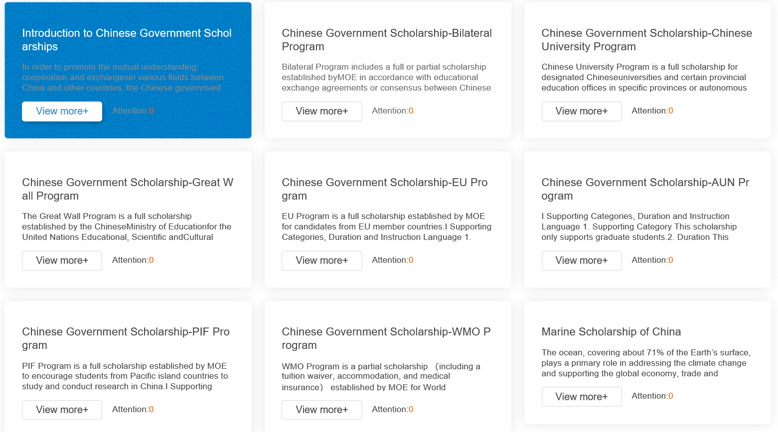
0. CSC—China Scholarship Council-2/4
http://www.campuschina.org/scholarships/index.html

Slide 6
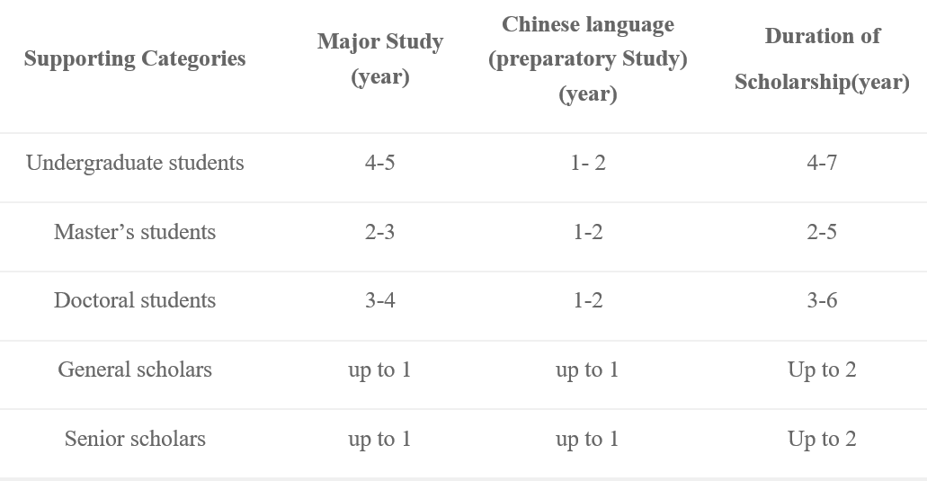
0. CSC—China Scholarship Council-3/4

Slide 7
0. CSC—China Scholarship Council-4/4
Full Scholarship covers
Tuition
Waiver
Accommodation:
Free university dormitory or accommodation subsidy
Stipend:
Undergraduate students: CNY 2,500 per month
Master’s students/general scholars: CNY 3,000 per month
Doctoral students/senior scholars: CNY 3,500 per month

Slide 8
1. Funding-1/2
DUT side
DUT
CSC (http://www.campuschina.org/)
Other third party (from companies/organizations) from China
FU side
FU
Other third party (from companies/organizations)

Slide 9
1. Funding-2/2
CSC-China Scholarship Council
Supporting Chinese students to go abroad
Pursuing Ph.D. : 4-year grant, about 1200 Euros/month for living cost
Joint doctoral training: 2-year grant, about 1200 Euros/month for living cost
Supporting international students to come to China
Pursuing Ph.D. : 4( or 5)-year grant, 3500 Yuan RMB/month for living cost
http://www.campuschina.org/content/details3_74776.html
Note-1: ‘international students’ indicate that the students do not hold the China passport
Note-2: ‘international students’ include foreign-country born Chinese

Slide 10
2. Degree
Single degree: One-Dissertation-One-Degree
The student is registered in DUT or FU, but is jointly supervised
Joint degree: One-Dissertation-Joint-Degree
The student is registered in both DUT and FU, and is jointly supervised
Each Univ. confers one degree and ‘Joint training program’ is marked
Dual degree: Two-Dissertation-Two-Degree
The student is registered in both DUT and FU, and is jointly supervised
The student should write 2 dissertations with less than 30% overlap
Each Univ. confers one individual degree

Slide 11
3. Programs for DUT students
International Cooperative Programs for Innovative Talents (ICPIT) and Regular Programs from CSC
R = M + N + K students
M students pursuing Ph.D. —4-year grant
Candidates: DUT master students after getting degrees in June
N doctoral students for joint training—2-year grant
Candidates: DUT doctoral students
K post-doctors—1 or 2-year grant
Candidates: DUT junior and young researchers including faculty staff and post-doctors

Slide 12
4. Programs for FU students
Chinese Government Scholarship Programs from CSC
R = M + N + K students
M students pursuing Ph.D. —4-year grant
Candidates: FU master students after getting degrees in the same year when applying the CSC grant
N doctoral students for joint training—2-year grant
Candidates: FU doctoral students
K post-doctors—1or 2-year grant
Candidates: FU junior and young researchers including faculty staff and post-doctors

Slide 13
5. Nine-year Excellent Researcher Program --NERP
Motivation
Attracting the very-well motivated students for research
Training the very-well motivated students in 9 years continuously
Doing research for a challenging & significant topic in 9 years continuously
9 = 1+2+4+2
1: Senior undergraduate
2: Master
4: Doctor
2: Post-doctor
Funding comes from the above-mentioned
Joint Curriculum
Joint training

Slide 14
谢 谢！
Thank You!

